Slide 1
From the field – Building a secure script with Graph API
Andreas Hähnel

Slide 2

Many thanks to our sponsors:

Slide 3

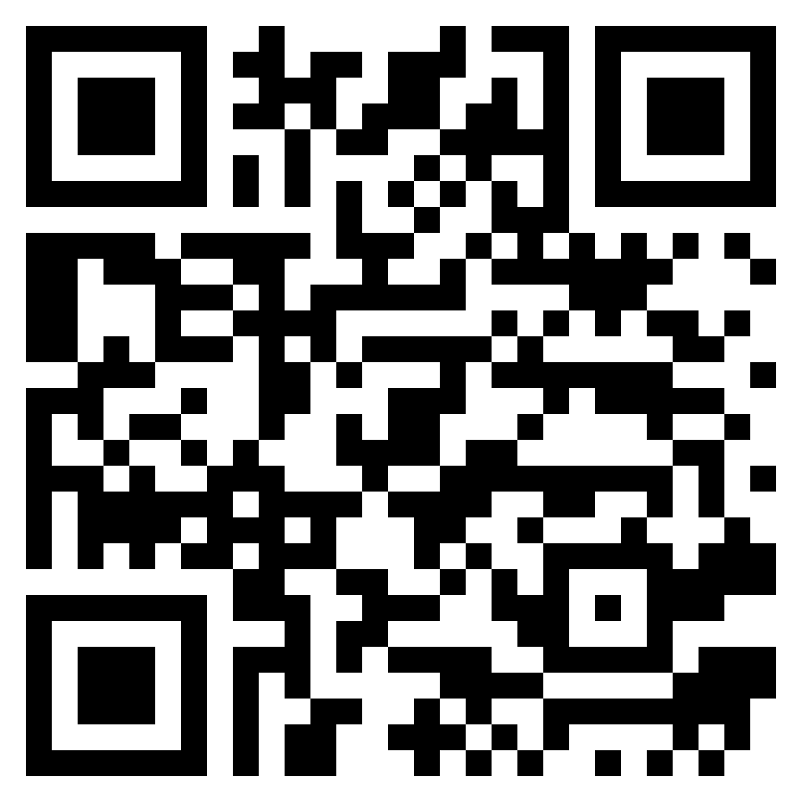
Andreas Hähnel
2002: Lotus Notes Admin & Developer
2008: Exchange 2007 PowerShell 💖
Since 2013: focussed on Microsoft Cloud
Senior Consultant
Cloud Solutions Architect
Problem-solver with PowerShell 🧙‍♂️
Sarcasm is always free of charge 🤘
Connect with me:

Slide 4
Some (short) basics to start…

Slide 5
About the MS Graph
MS Graph is THE new comprehensive interface
For scripting
For “hardcore” development
Graph is REST based
API Calls are an URL / https request
GET | POST | PATCH | PUT | DELETE + body (with content)
Graph Explorer (this is a trustworthy link, click it 😉)
You need to authenticate

Slide 6
About the MS Graph
The Graph API has an RBAC permissions model Delegated | Application
Resource.Operation.Constraint
Directory.Read.All
Directory.ReadWrite.All
Apps can run as daemon or user
User account / service account / admin account
AAD App Registration (with AAD Enterprise App)

Slide 7

Your tasks to secure a Graph App
Background-job or user sign in required?
How can the access be maintained?
Who must access?
Who may access?
Which kind of permissions does my app require?
Which resources do I have to access?

Slide 8

(real) Example Use Case
Our Service Desk needs a comprehensive list of all our users
Our Service Desk needs that list in SharePoint

Slide 9
Your tasks to secure a Graph App
Which resources do I have to access?
Azure AD
SharePoint Online
My AAD group “Service Desk”, but do they?
Who must access?
Who may access?
Background-job or user sign in required?
How can the access be maintained?
Which kind of permissions does my app require?
Unattended script
Access via “password” or certificate
Read AAD users
Write something to a SPO list

Slide 10
Demos
We love Demos!
Notes:
AAD – App “PSConfEU2022” registrieren
Permissions kurz erklären
Rechte “Directory.ReadWrite.All” und

Slide 11
Create Service Principal with PS
Connect-AzureAD #Module AzureAD required!
$myAppRegistration = 'PSConfEU'
$appHomepageURL = 'https://localhost:12345'
$appReplyURL = 'https://localhost:12345/signin-oidc'
$myCoolApp = New-AzureADApplication -DisplayName $myAppRegistration -AvailableToOtherTenants $false -Homepage $appHomePageUrl -ReplyUrls @($appReplyUrl)
# New-MgApplication
# now create the Service Principal from that app
$myEnterpriseApp = New-AzureADServicePrincipal -AppId $myCoolApp.AppID -Tags @(“WindowsAzureActiveDirectoryIntegratedApp”,”PSConfEU”)
# New-MgServicePrincipal
# now be happy with Conditional Access!

Slide 12
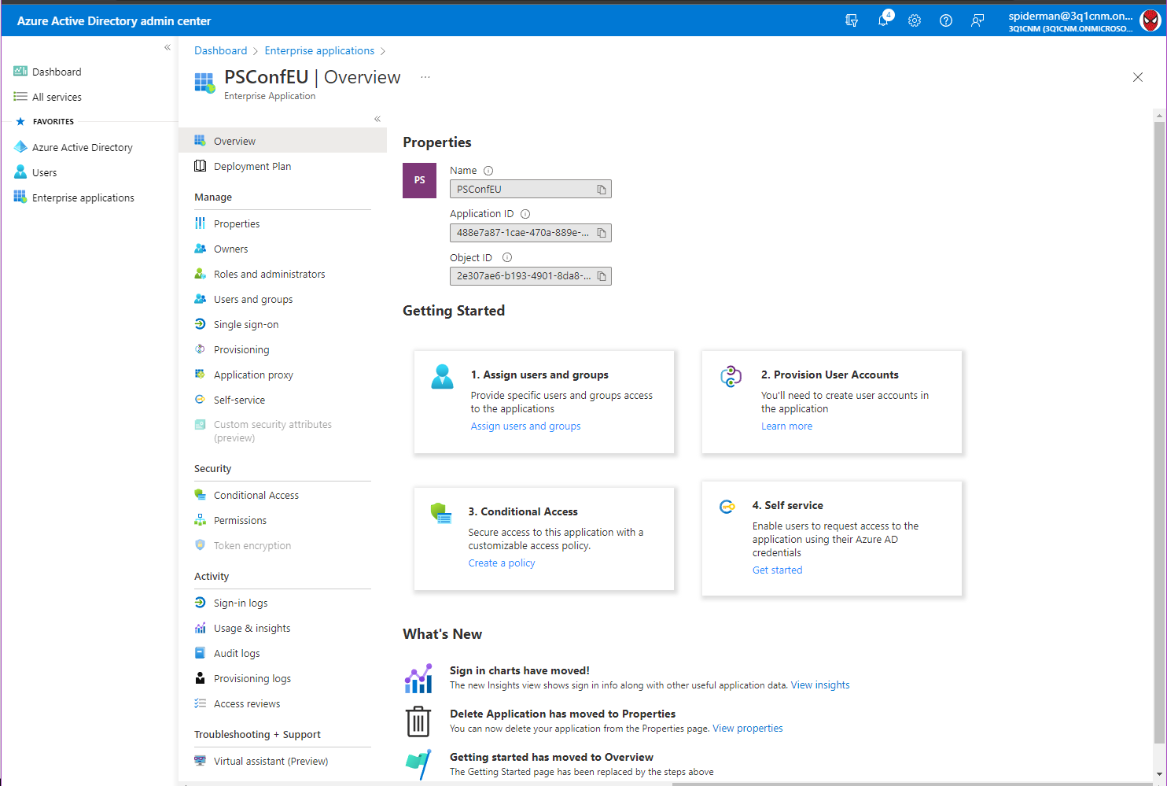

Slide 13
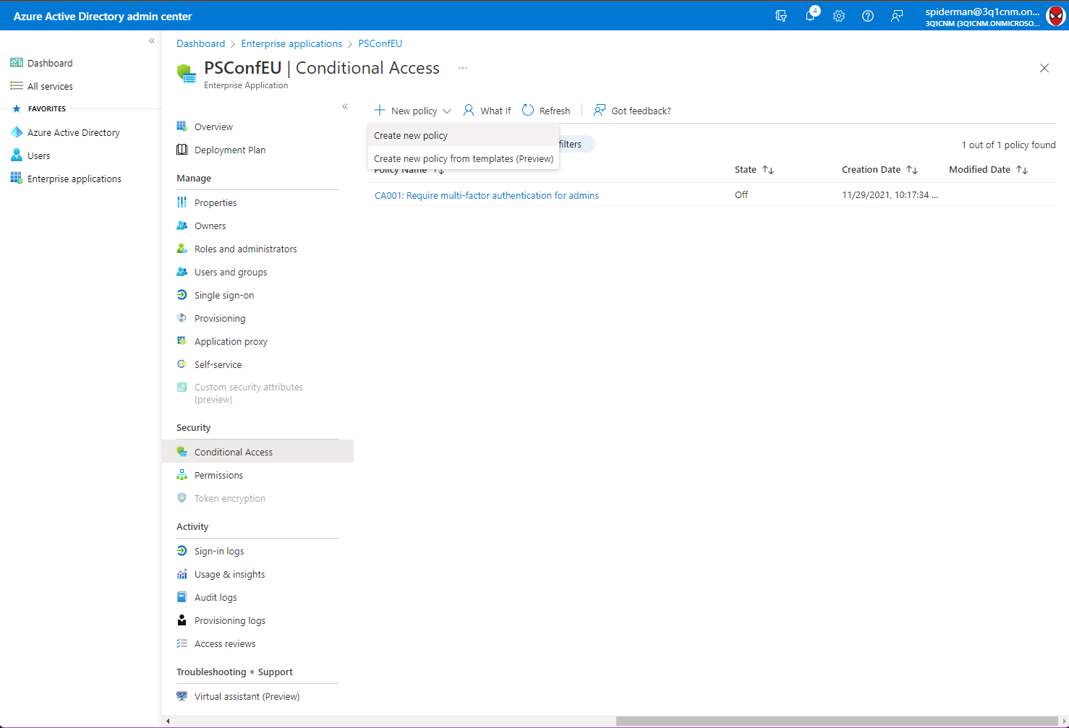

Slide 14
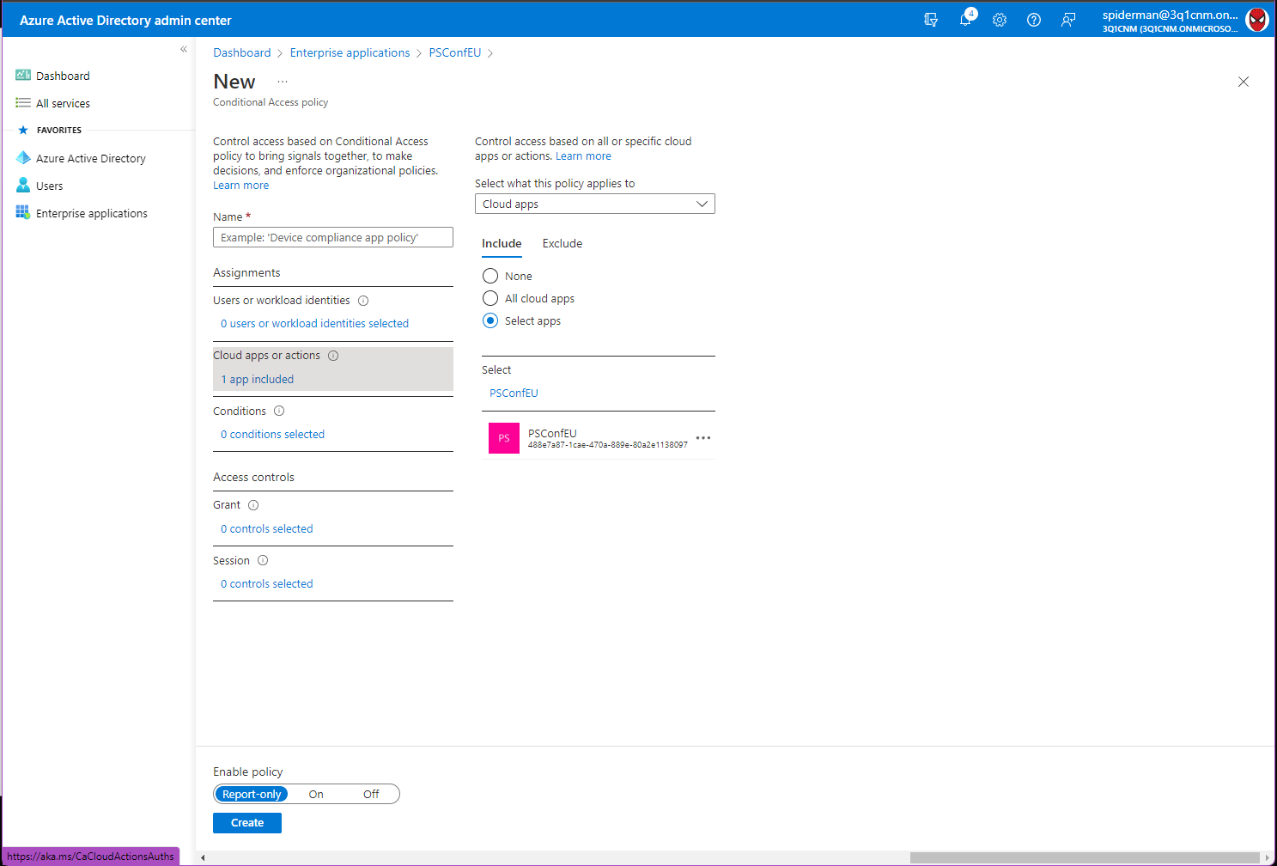

Slide 15
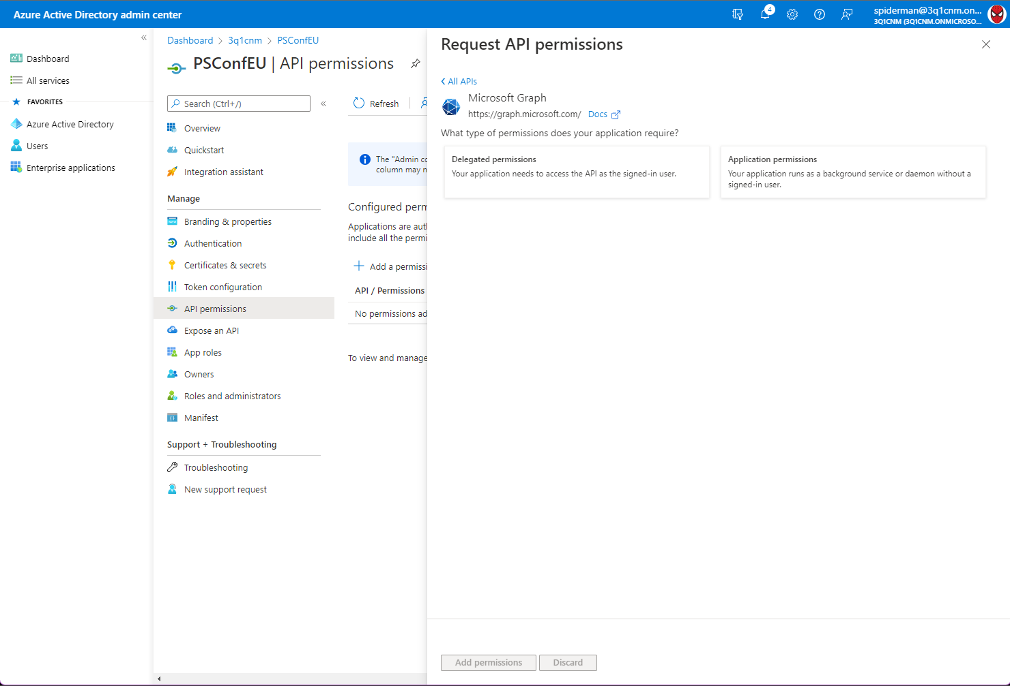
App created – now the permissions

Slide 16
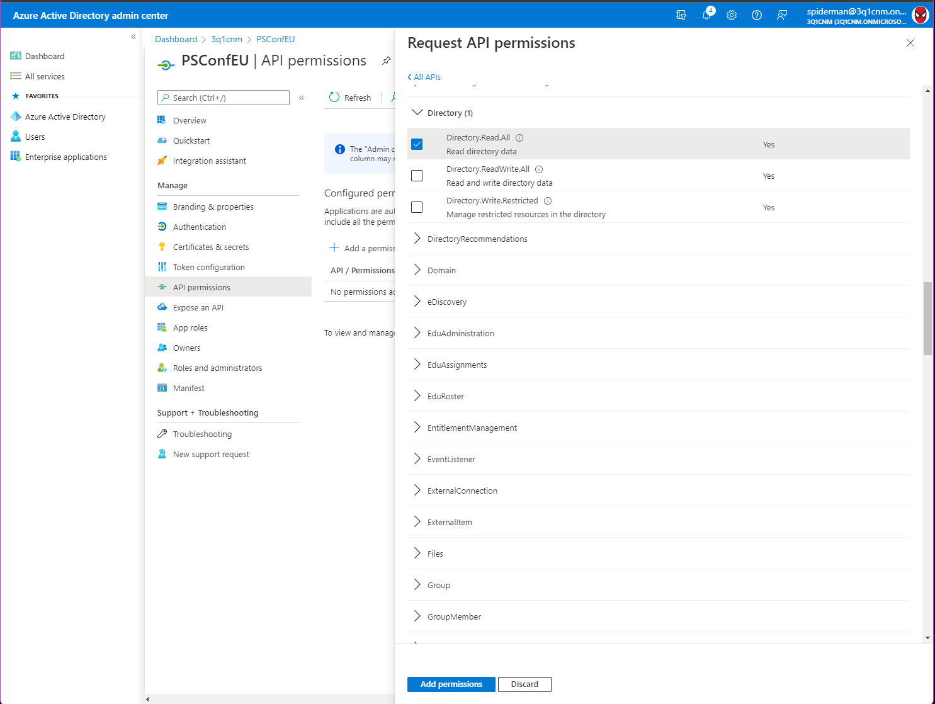
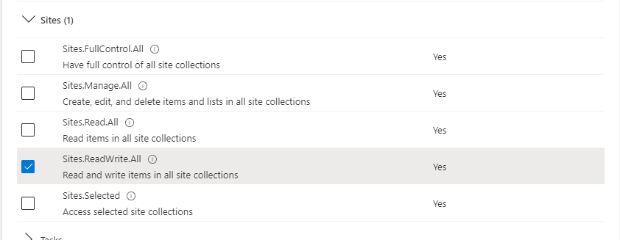
App created – now the permissions

Slide 17
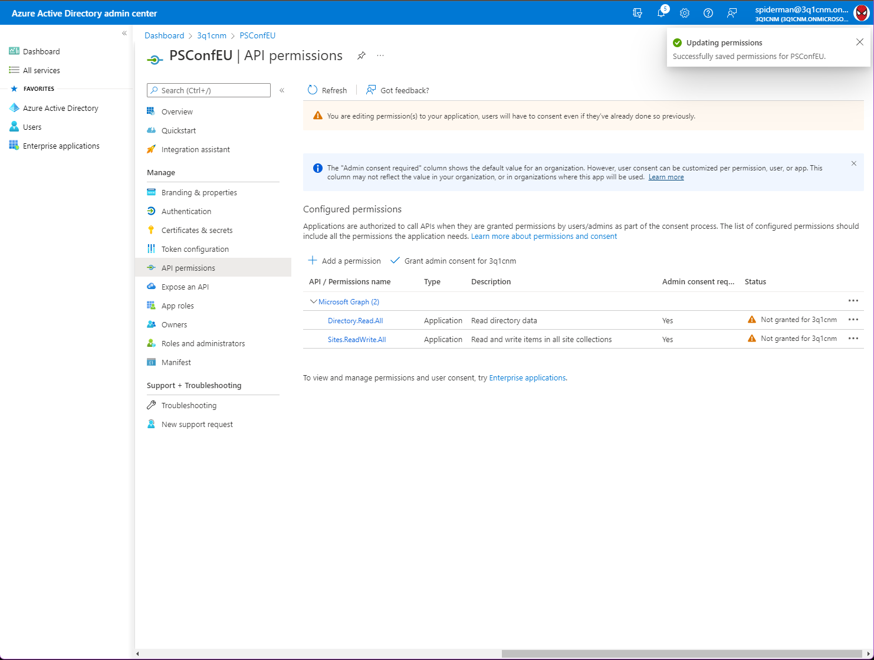
App created – now the permissions

Slide 18
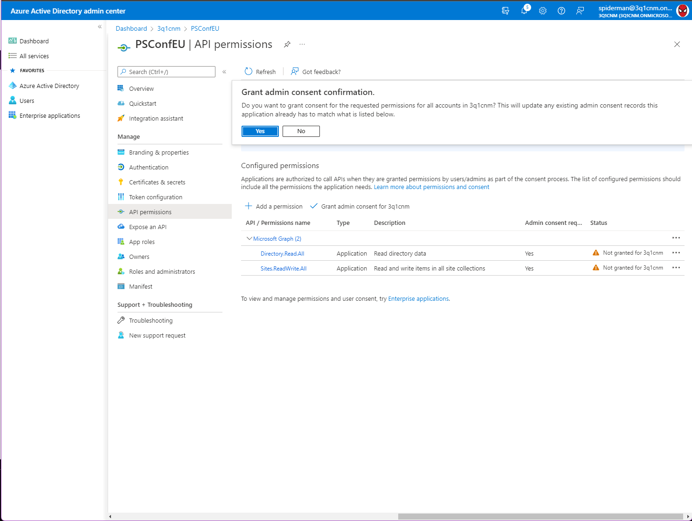
App created – now the permissions

Slide 19
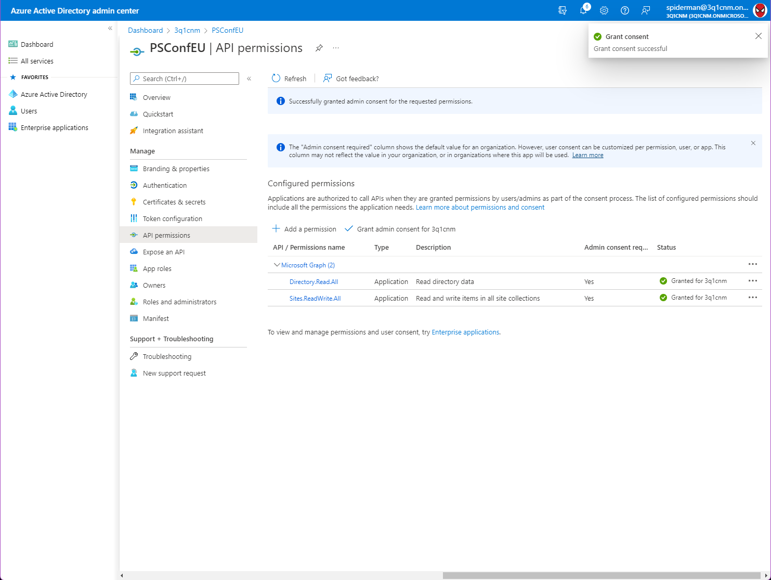
App created – now the permissions

Slide 20
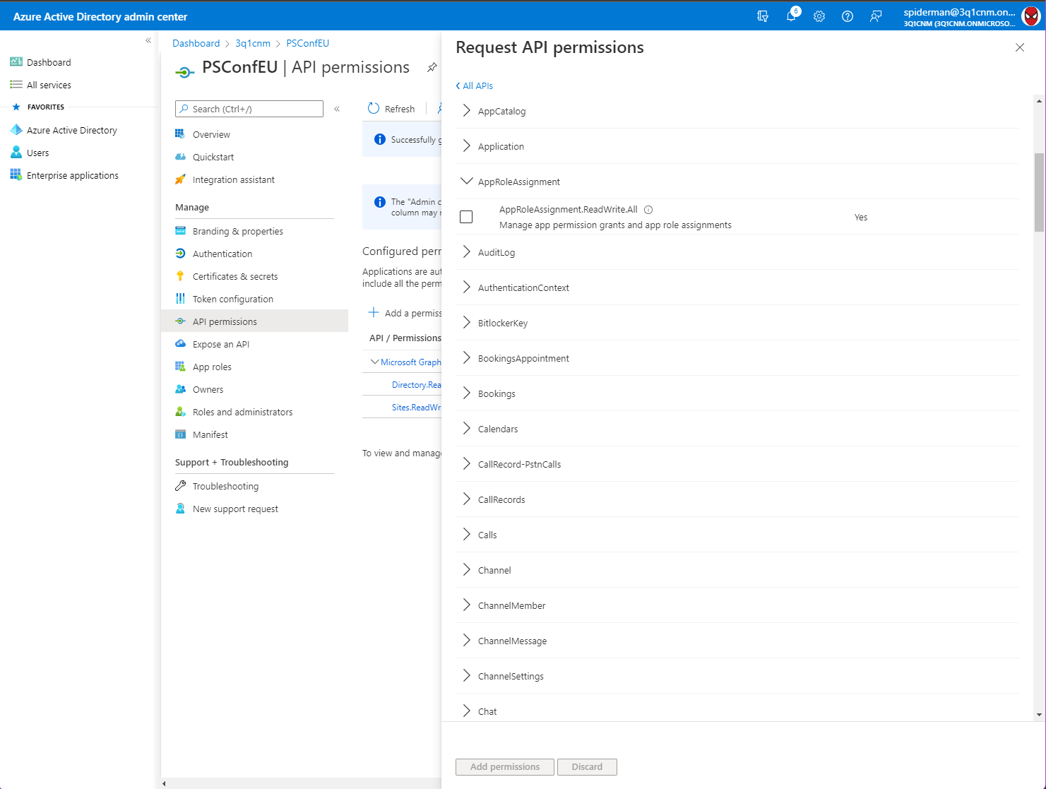

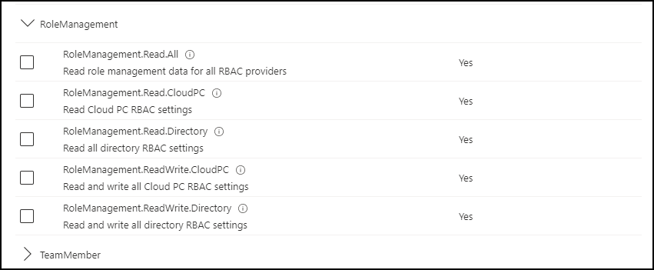
App created – now the permissions
With that permission,
the app can do ANYTHING
e.g.
grant GA
infiltrate
delete
create
...
An attacker might gain
access to M365 and
Azure resources!

Slide 21
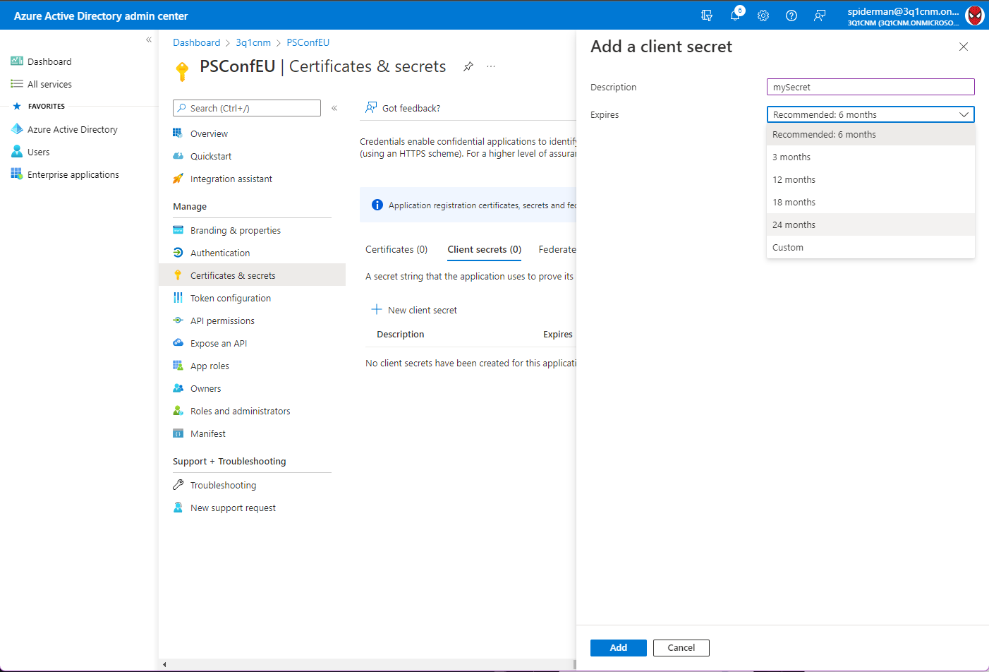
App permissions set – now the login
The easiest way: “username” + password (similar)

Slide 22
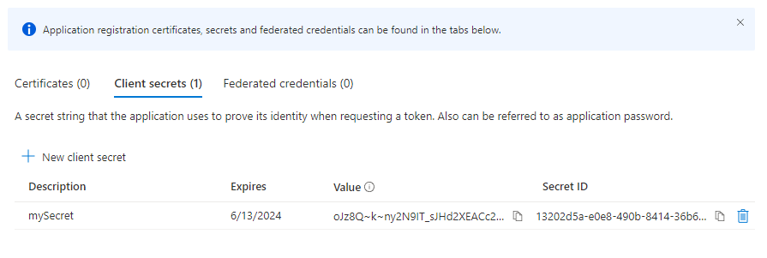
App permissions set – now the login
Secret is available only on generation and complex:

Slide 23
App permissions set – now the login
Connect-AzureAD #Module AzureAD required!
$myAppRegistrationID = "<YOUR APP ID>"
$newSecret = New-AzureADApplicationPasswordCredential -ObjectId $myAppRegistrationID -CustomKeyIdentifier "PowerShellGenerated" -StartDate (get-date) -endDate (get-date).AddDays(720)

Slide 24
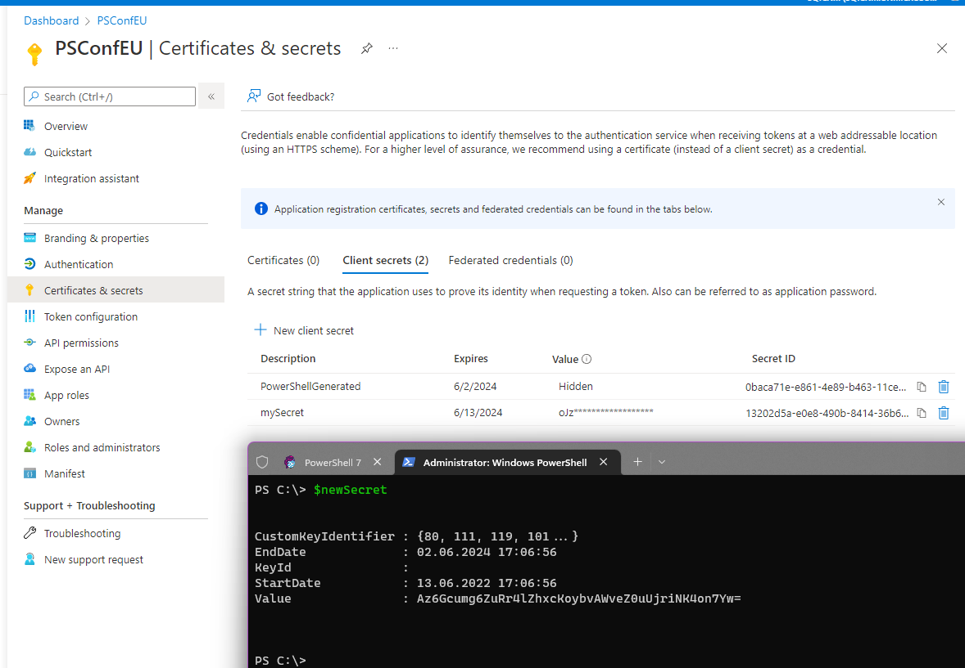
App permissions set – now the login
And here we go:
Power Tip:
Use Azure KeyVault
Quickstart - Create an Azure Key Vault with Azure PowerShell | Microsoft Docs

Slide 25
App permissions set – now the login
Alternative: [Self-Signed] certificate without private key
HINT: self-signed not recommended for production
.cer, .crt or .pem supported
Power Tip:
Use Azure KeyVault
Quickstart - Create an Azure Key Vault with Azure PowerShell | Microsoft Docs

Slide 26
App permissions set – now the login
$myAppRegistrationID = "<YOUR APP ID>"
New-SelfSignedCertificate -Subject "CN=PSConfEUCertificate" -KeySpec Signature -CertStoreLocation "cert:\CurrentUser\My" -KeyExportPolicy Exportable -KeyLength 2048 -KeyAlgorithm RSA -HashAlgorithm SHA256 -NotAfter (Get-Date).AddYears(10)
$thumbprint = (Get-ChildItem "cert:\CurrentUser\My" | Where-Object {$_.Subject -eq "CN=PSConfEUCertificate"}).Thumbprint
if ($tmppath -eq $false) {New-Item C:\cert -ItemType Directory}
#PFX
$certPW = "myUncrackableSecret123!"
$certPW = ConvertTo-SecureString -String $certPW -Force -AsPlainText
Export-PfxCertificate -cert "cert:\CurrentUser\my\$thumbprint" -FilePath C:\cert\PSConfEUCertificate.pfx -Password $certPW
$cert = New-Object System.Security.Cryptography.X509Certificates.X509Certificate("C:\cert\PSConfEUCertificate.pfx", $certPW)
$keyValue = [System.Convert]::ToBase64String($cert.GetRawCertData())
New-AzureADApplicationKeyCredential -ObjectId $myAppRegistrationID -CustomKeyIdentifier "PSConfEU" -Type AsymmetricX509Cert -Usage Verify -Value $keyValue
#CER
Get-ChildItem "Cert:\CurrentUser\My\$thumbprint" | Export-Certificate -FilePath "C:\cert\PSConfEUCertificate.cer"
$CERcert = New-Object System.Security.Cryptography.X509Certificates.X509Certificate("C:\cert\PSConfEUCertificate.cer")
$keyValue = [System.Convert]::ToBase64String($CERcert.GetRawCertData())
New-AzureADApplicationKeyCredential -ObjectId $myAppRegistrationID -CustomKeyIdentifier "PSConfEU" -Type AsymmetricX509Cert -Usage Verify -Value $keyValue

Slide 27
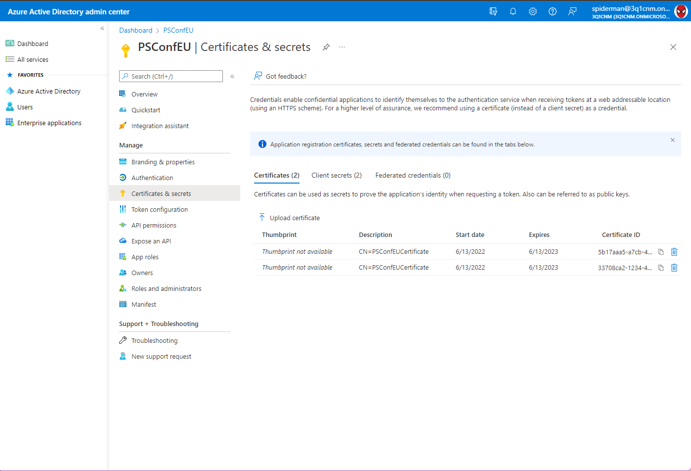
App permissions set – now the login

Slide 28
Interim summary
We have an App Registration in AAD
The app is controlled via Conditional Access
The app has limited permissions (no “golden ticket”)
The app can authenticate via secret (max 2 years)
OR:
The app can authenticate via certificate

Slide 29
Interim summary
The name of the permission scopes sound like a nightmare for some use cases:
Directory.ReadWrite.All
Mail.ReadWrite {.All}
Sites.ReadWrite.All

Slide 30
Scope your Exchange Online app
Magical keyword: “Application Access Policy”
Define a security group that contains all users, the app needs access to
Limiting application permissions to specific Exchange Online mailboxes - Microsoft Graph | Microsoft Docs

Slide 31
Scope your Exchange Online app
$myAppRegistrationID = "<YOUR APP ID>"
#AppID, not ObjectID!
New-ApplicationAccessPolicy -AppId $myAppRegistrationID -PolicyScopeGroupId "TargetedUsers@contoso.com" -AccessRight RestrictAccess -Description "Restrict this app to members of this security or distribution group"

Slide 32
Scope your Exchange Online app
Good to know:
Approximately 300 policies (if you don’t use description) 😵😖
DenyAccess: access data for users that are NOT specified in the group (e.g. exclude Management & HR)
RestrictAccess: access for group members ONLY to this data (e.g. Read only calendar, not email)
DENY wins over RESTRICT (for the same app!)

Slide 33
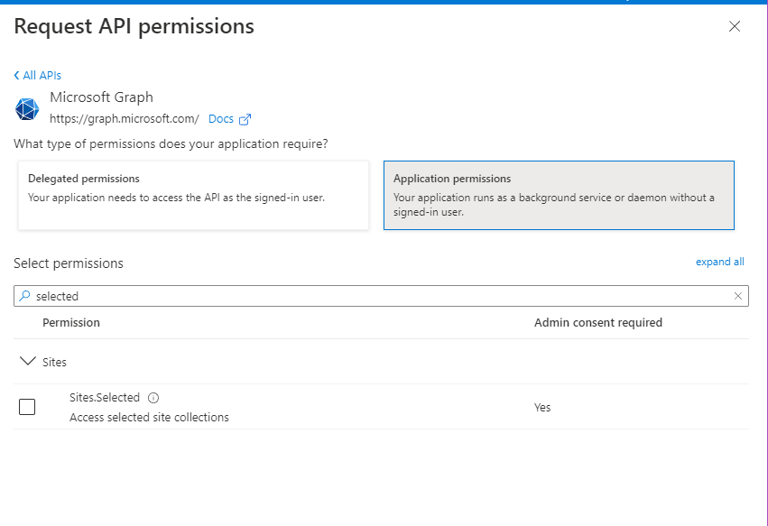

Scope your app in SharePoint
Seems to be easy:

Slide 34
Scope your app in SharePoint
You need 2 apps:
The app that will later do the real work
A kind of Admin App to grant your worker app permissions
The Admin App needs high privileges
The Worker App permissions are only visible in the app

Slide 35
Scope your app in SharePoint
$SiteCollectionRelativePath = "3q1cnm.sharepoint.com:/sites/PSConfEU22"
$tenantID = "<YOUR TENANT ID>"
#Worker App
$appID = "<YOUR WORKER APP ID>"
#Admin App
$appIDAdminApp = "<YOUR ADMIN APP ID>"
$secretAdminApp = "j4C8Q~TB1Zj-f4FaCqtQG"

Slide 36
Scope your app in SharePoint
function Get-GraphAuthorizationToken {
Get-OAuth2TokenMagically
}
Get-GraphAuthorizationToken -TenantID $tenantID -AppID $appIDAdminApp -ClientKey $secretAdminApp
$uri = "https://graph.microsoft.com/v1.0/sites/$SiteCollectionRelativePath"
$GraphResultSiteCollection = Invoke-RestMethod -Method Get -Uri $uri -Headers $script:APIHeader
$siteID = $GraphResultSiteCollection.id.Split(",")[1]
# verify in Graph Explorer

Slide 37
Scope your app in SharePoint
$body = @“
{
"roles": [“write"], # write | read; “owner” is mentioned in the documentation but didn’t work for me
"grantedToIdentities": [
{
"application": {
"id": "$appID",
"displayName": "WorkerApp"
}
}
]
}
"@ $uri = "https://graph.microsoft.com/v1.0/sites/$siteID/permissions" # and store the permissions for the app:
Invoke-RestMethod -Method Post -uri $uri -Headers $script:APIHeader -Body $body -ContentType "application/json; charset=utf-8"

Slide 38
Coming to the end – some pitfalls
Avoid AppRoleAssignment.ReadWrite.All and RoleManagement.ReadWrite.Directory (without monitoring)
Graph Development productive only against v1.0
Graph Development in a Lab also against beta
Establish governance and lifecycle for apps, secrets and certificates
Delete (or disable), what you don’t need any more

Slide 39
Summary
Graph Development is extremely powerful
Without good knowledge you can create wholes in the tenant, you do not want to have
With the basics above you can establish a great security baseline
Keep your eyes open for improvements from Microsoft and improve continuously

Slide 40
Q&A
15 minutes

Slide 41
Microsoft Graph is the large new modern API to access Microsoft 365 data. Developing with Graph can be fun, but like every API it requires actions to make a script or program secure. This sessions shows common mistakes and gives tipps how to secure your own Graph API PS Script. It will cover topics like permission models, CBA, CA, scoping and more.

Slide 42
Slide title
Sample text for your PSConf.EU 2022 presentation
We usually prefer demos, use slides with moderation
Think about those at the back of the room, some text might be too small.
Think about accessibility, try to improve the contrast, colours and size of your presentation.

Slide 43
Instructions
Use this template if you want, it’s preferred but not mandatory.
Please make sure our sponsors are mentioned on your first slide after the title.
Do not amend the ratio or the colours of the sponsors’ logo and background.
Update your twitter handle through the master page (see next slides).

Slide 44
Instruction (Continued)
The session is 30 min.
Then 15min Q&A.
At the end of your 45 min, please leave the room to the next speaker.
You’re welcome to continue the discussion in the Foyer area.

Slide 45
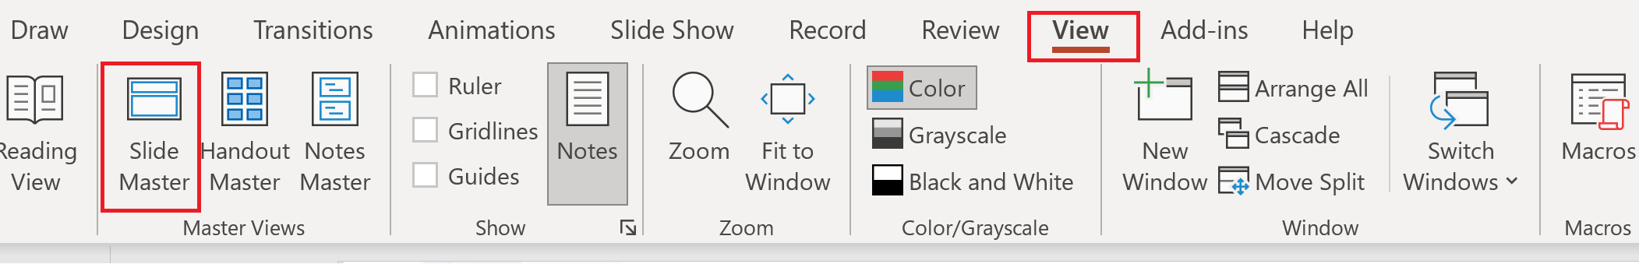
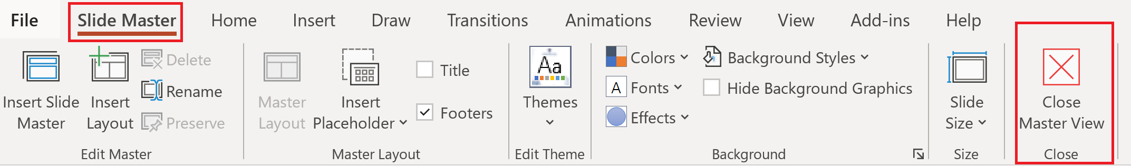
Update the twitter handle on the master slide
To open the slide master:
To close the Master view:
If you need any help, do not hesitate to email us at psconfeu@synedgy.com

Slide 46
Demos
We love Demos!

Slide 47
Q&A
15 minutes

